Slide 1
Smartphone Usage Analytics
Presented by:
Mohammed Ayaz Maniar (019) Ruchin Patel (037)

Slide 2
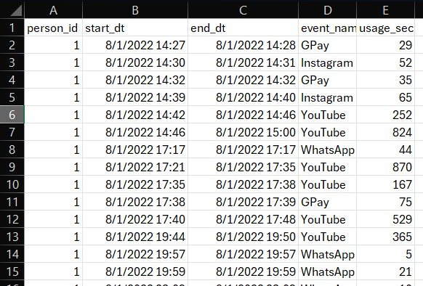
Dataset
Dataset preprocessing:
Merge data of all users
Removed unwanted packages
Final Data:
App usage data of 16 individuals
Include start date_time and duration
For most people data: is of July-sept month
After preprocessing:
Total rows: 54038

Slide 3
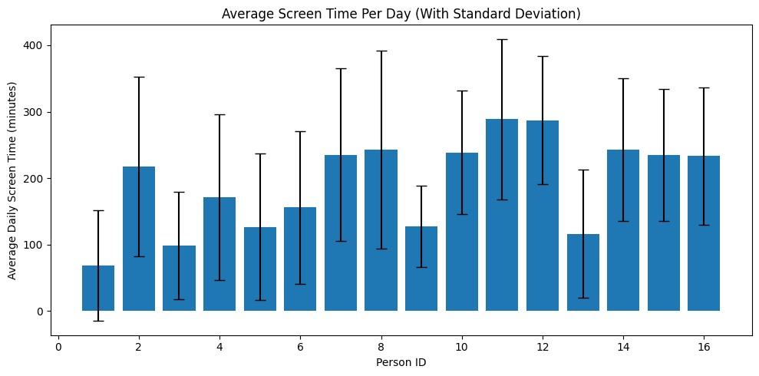
🕒 Average Daily Screen Time per User
Shows average hours spent daily by each user.
Error bars represent variation (standard deviation).
Heavy users can be easily identified.
Insight:
Users 11 and 12 have the highest average screen-time.

Slide 4
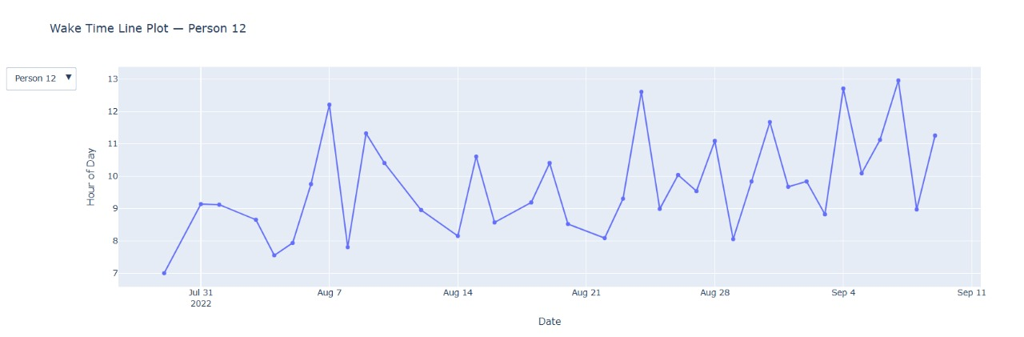
Sleep Wake Cycle
Insight:
Person 12 shows consistent wake-up between 8AM–11AM,
indicating healthy and stable sleep patterns.

Slide 5
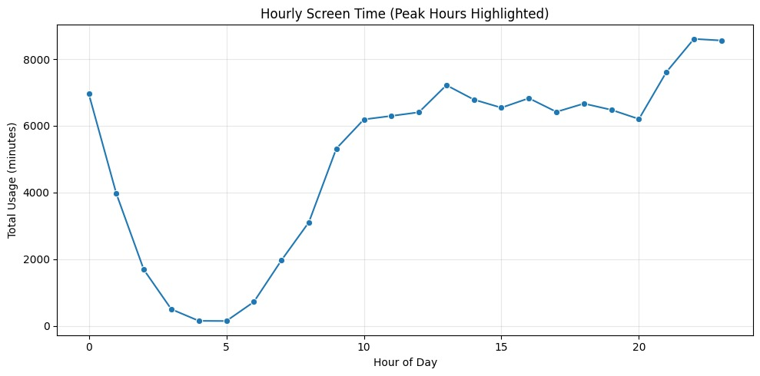
Hourly Usage Pattern
Displays total usage across each hour of the day.
Activity is lowest between 2 AM – 6 AM.
Peaks occur during 8 PM – 11 PM.
Insight:
Evenings dominate — likely due to entertainment and social apps.

Slide 6
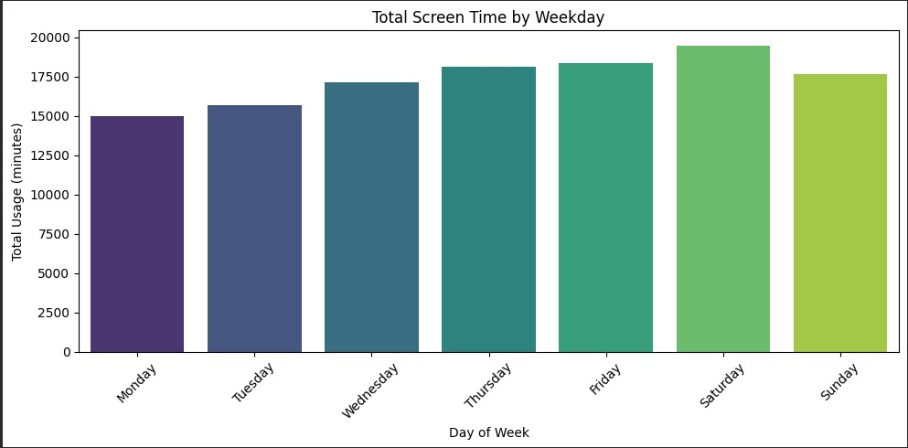
Weekly Usage Pattern
Content:
Users are most active on Saturdays.
Monday & Tuesday show relatively less engagement.
Insight:
Leisure time drives higher screen-time on weekends.

Slide 7
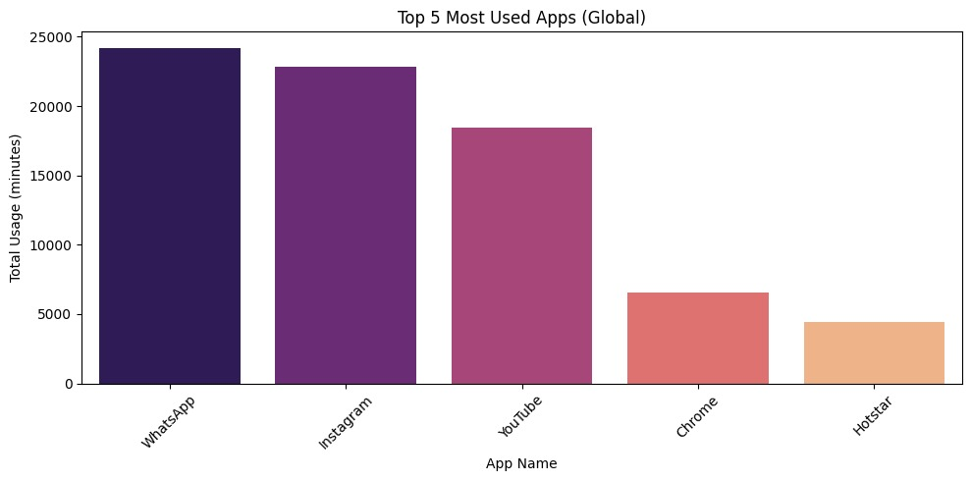
Top 5 Most Used Apps (Global)
Content:
Global app ranking by total screen time.
Social & media apps dominate usage share.

Slide 8
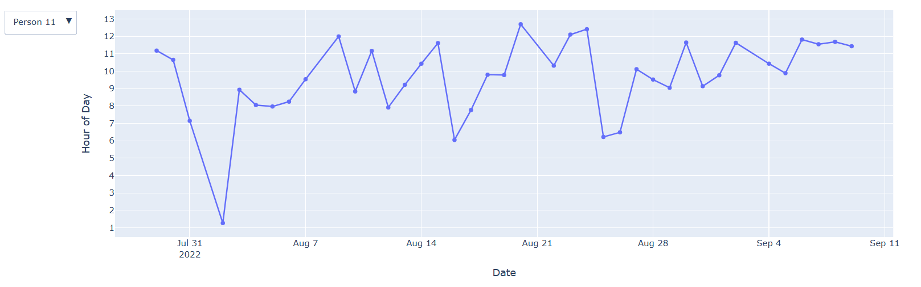
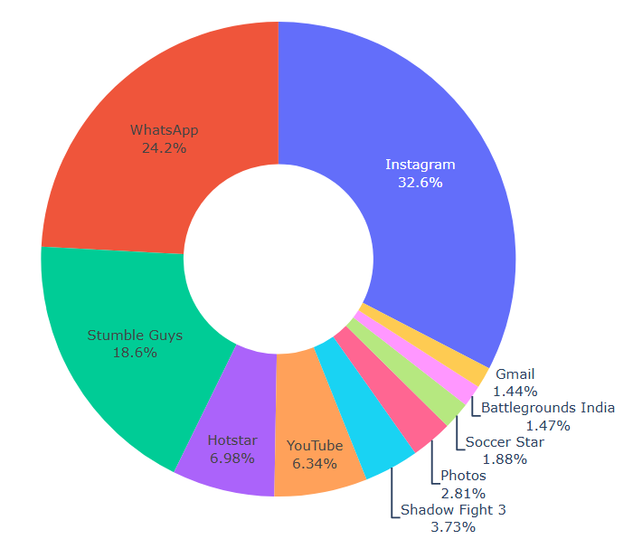
Individual User Usage
Individual-level insights reveal unique patterns
For example, Person 11 spends the most time on Instagram, followed by WhatsApp and gaming apps like Stumble Guys.

Slide 9
Key Findings & Insights
📱 Social media & video streaming dominate total usage.
🌇 Peak screen-time in evenings and weekends.
💤 Sleep detection aligns with regular daily cycles.
👥 High inter-user variation — possible lifestyle correlation.

Slide 10
Future Scope
Predict next-day usage using ML models.
Cluster users by digital habits.
Correlate screen-time with productivity or mood.

Slide 11
Thank You

